Slide 1
Team 4 Final Project
Ethics of Autonomous Vehicles
Mason Hale, Herman Hettinger, Daniel Hutchins, Jonathan McCarrick, Ryan Taylor

Slide 2
What are automated vehicles?
An autonomous vehicle is a vehicle that can drive itself without input from a human driver. There are several levels of self-driving vehicles, depending on their level of automation. These levels have been defined by the Society of Automotive Engineers (SAE) which has set 6 of them adopted by the U.S. Department of Transportation ranging from Level 0 (fully manual) to Level 5 (fully autonomous).
Notes:
Source: https://www.techopedia.com/definition/30056/autonomous-vehicle

Slide 3
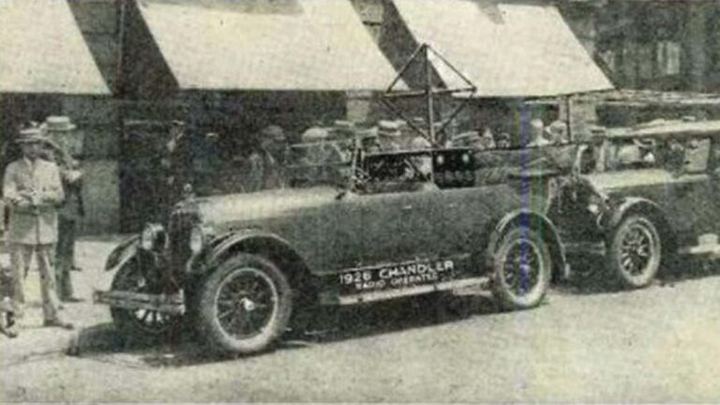
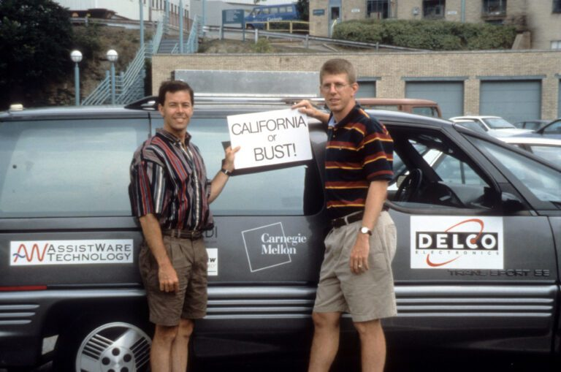
The History
In the 1500s, Leonardo Davinci created a diagram using springs that was said to be the first robot
In 1925, Francis Houdina demonstrated a radio controlled car throughout the street.
In 1939, General Motors created the first self-driving car model, and the first model was actually built in 1958.
In 1995, Carnegie Mellon researchers took the first self driving car to the road from Pittsburgh, all the way to California, only controlling the speed and brakes.
Today autonomous vehicles have become a reliable source of transportation, through companies such as Tesla.
Notes:
https://www.tomorrowsworldtoday.com/2021/08/09/history-of-autonomous-cars/

Slide 4
Present applications for Autonomous vehicles
Autonomous Vehicles are currently used in everyday life
Some Common applications for autonomous vehicles are:
Use of consumer vehicles such as self driving cars.
Use of industrial equipment, such as factory AI that transports goods/perform tasks within the organization.
Military use of autonomous vehicles, such as surveillance and weapons drones.

Slide 5
Rising tech companies in the industry
Tesla
Most vehicles today have the ability to engage it’s autopilot feature.
Human supervision/intervention is still needed when autopilot is engaged.
Many headlines on the shortcomings of Tesla’s autopilot feature.

Slide 6
Rising tech companies in the industry
Pony.ai
Focus is on “robo-taxis”.
Large scale testing in California and China.
First license in china to test Automated semi trucks for shipping.

Slide 7
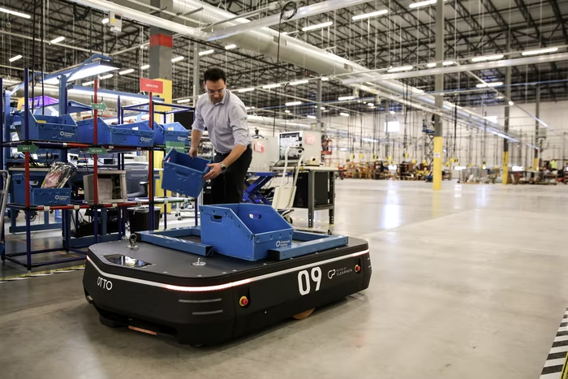
Autonomous vehicles in the workplace
Many companies use AI or autonomous vehicles to support the infrastructure of their companies.
These AI and automated vehicles make it so that project completion and workflow is made easier for human workers.
Jobs are being completed with more accuracy due to AI help, and ability to detect deficiencies 80% more.
Notes:
https://www.mckinsey.com/business-functions/mckinsey-digital/our-insights/building-smarter-cars

Slide 8

Civilian autonomous vehicles
Autonomous vehicles have made consumer life much easier.
The Autonomous vehicles that we see today in the consumer life:
Make it so that the vehicle can control all aspects of transportation for the driver.
Make electric vehicles available to the public, giving more access to affordable travel.
Current day Autonomous consumer companies include:
Tesla
BMW
Nissan
Chevrolet

Slide 9
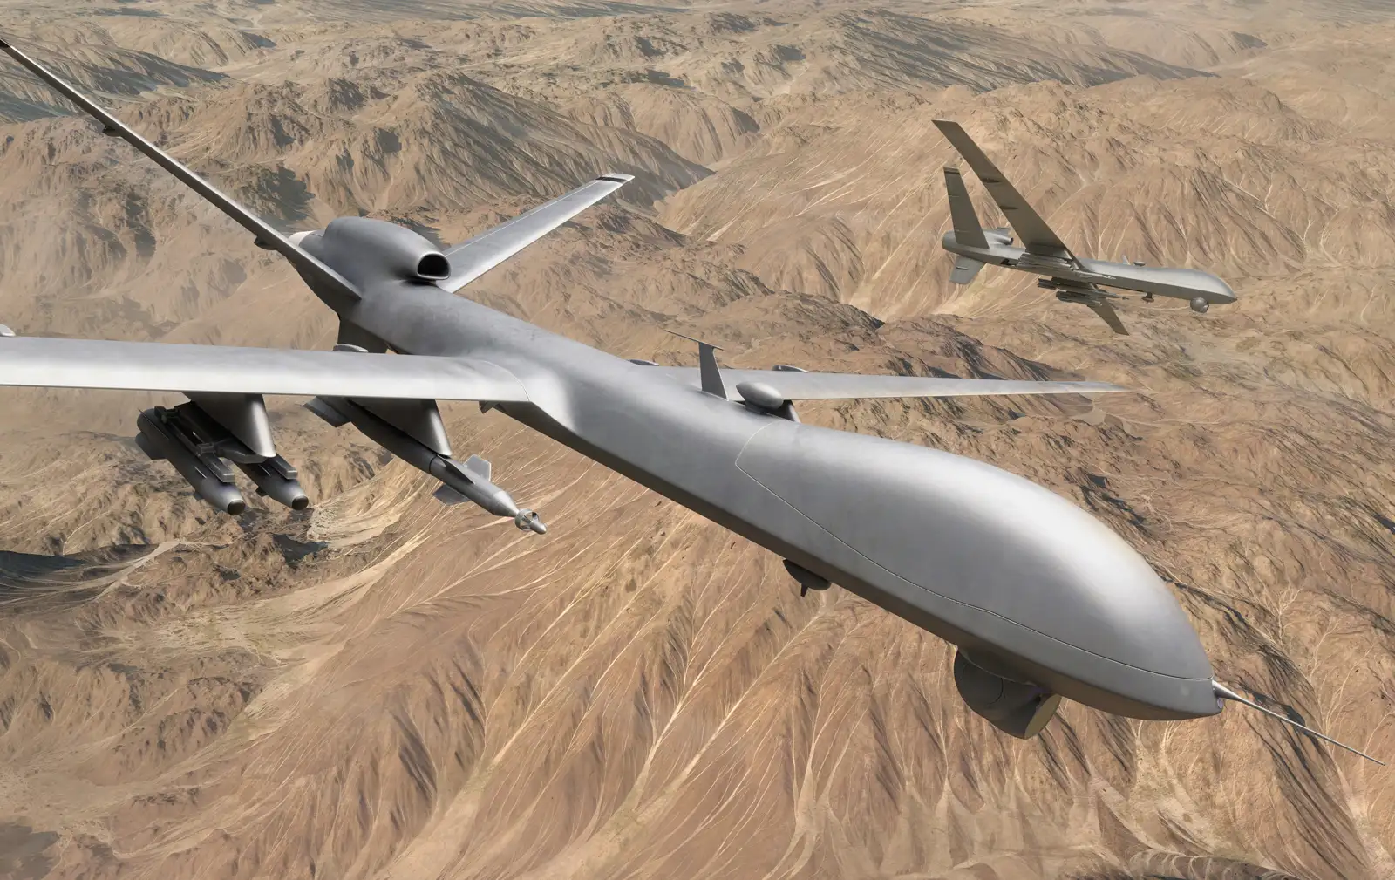
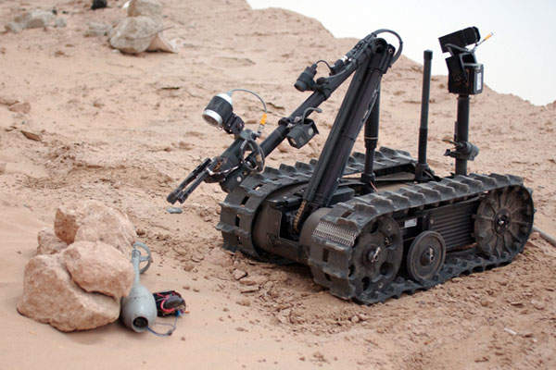
Military Autonomous vehicles
Autonomous vehicles have and will be used to go places too dangerous for soldiers to venture. Some examples of these autonomous military vehicles are:
Bomb Defusal Robots
Aerial attack drones
Surveillance drones

Slide 10
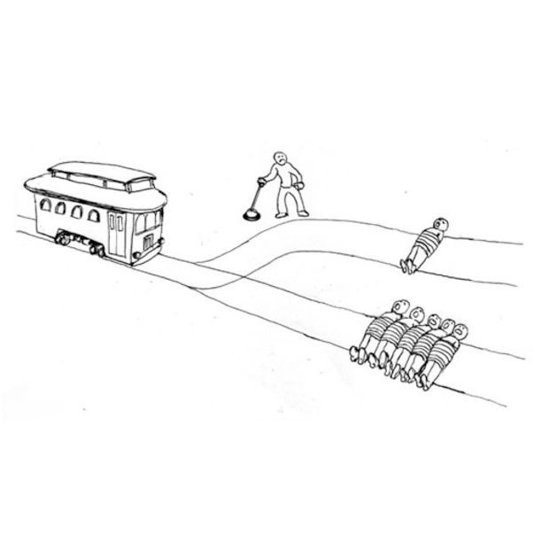
Ethical Dilemmas
How does the onboard system make real-time logical decisions?
Prime example: The Trolley Problem
Few manufacturers have answered this, as it stirs controversy.
Mercedes-Benz made their answer clear.
They will protect the passengers, regardless.
Security vs. convenience
How do autonomous vehicle manufacturers decide?
Security risks a major point of interest
Notes:
Orlove, Raphael. “Mercedes Decides Who an Autonomous Car Should Save and the Answer Is Worrying.” Jalopnik, Jalopnik, 13 Oct. 2016, https://jalopnik.com/mercedes-decides-who-an-autonomous-car-should-save-and-1787749419.
Technologies, !important Safety. “The ‘Trolley Problem’ of the Self-Driving Industry May Have Found a Solution.” Medium, Medium, 10 June 2020, https://medium.com/@importanttech/the-trolley-problem-of-the-self-driving-industry-may-have-found-a-solution-30e1d40ce78c.

Slide 11
Deontology vs teleology on automation
Deontology: universal rules set distinguish right from wrong.
Teleology: looks purely to the consequences of an action, and an agent must seek the least consequential decision.
Deontologists are concerned with means, teleologists are concerned with ends.
Example of a situation for an AI decision
Fork in the road: child on the left, elderly person on the right.
Teleology would turn right, as the child may live a full life.
Deontology may consider either path, prompting both have individual rights or life ahead of them.
A dilemma among developers.
Notes:
“Deontological Ethics.” Encyclopædia Britannica, Encyclopædia Britannica, Inc., 20 July 1998, https://www.britannica.com/topic/deontological-ethics.
“Teleological Ethics.” Encyclopædia Britannica, Encyclopædia Britannica, Inc., 24 Apr. 2008, https://www.britannica.com/topic/teleological-ethics.
Weiler, Reed. “Artificial Intelligence and Ethics: An Exploration of Machine Morality.” The World Mind, The World Mind, 11 Mar. 2020, https://www.theworldmind.org/home/2019/4/26/artificial-intelligence-and-ethics-an-exploration-of-machine-morality.

Slide 12
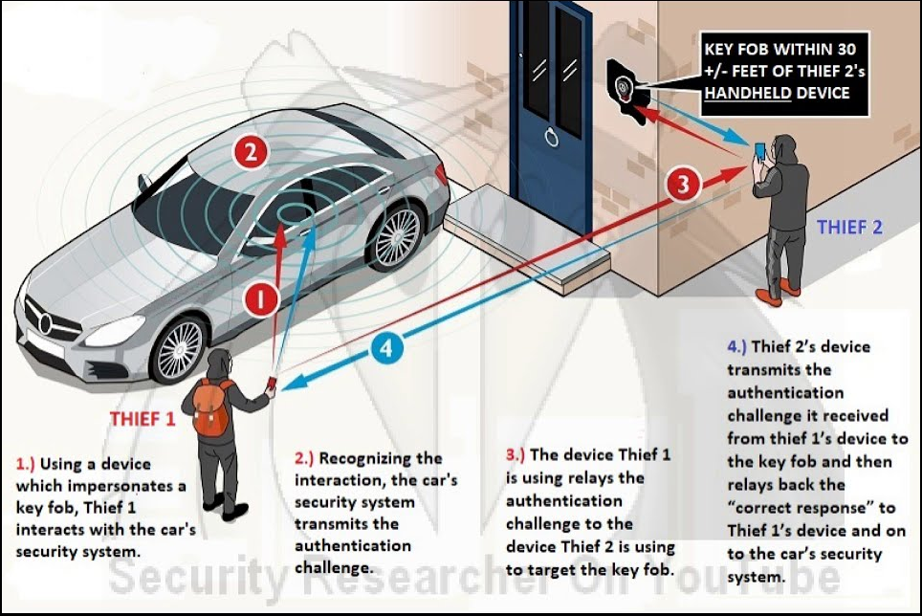
Security Risks
Bluetooth or relay attacks are one of the popular hacking methods.
Man-in-the-middle attack (2 people or 1 person with 2 devices)
(replay attacks solved on turn-key vehicles, rolling codes)
Data Alterations
Deleting frames in random intervals
Formatting video files to corrupt them
Affects real-time decisions by onboard system
Notes:
Boyd, Christopher. “Car Owners Warned of Another Theft-Enabling Relay Attack.” Malwarebytes Labs, 17 May 2022, https://blog.malwarebytes.com/hacking-2/2022/05/car-owners-warned-of-another-theft-enabling-relay-attack/.

Slide 13
The Future
More companies working on autonomous driving (ie. GM, Volvo, Volkswagen)
Sensors have become smaller and cheaper
New problems would arise, more cars on the road

Slide 14
Future of civilian Vehicles
While more Auto companies are investing in such projects, many have different ideas. Volkswagen is looking into subscription based service rather than owning the car. GM is looking to sell straight to the public. While Volvo is planning on fleets or to supply other competitors.

Slide 15
Future of warfare vehicles
As we get closer to Autonomous vehicles, one thing has stuck out for military uses, The security of it. Autonomous vehicles, like any other piece of computerized technology, are by definition susceptible to some degree of would-be attackers. Those attacks can potentially occur by tricking a vehicle’s cameras and sensors into veering into the wrong lane or by targeting software vulnerabilities much like one would on any other computer.
Notes:
https://gizmodo.com/the-pentagons-long-road-to-an-army-of-autonomous-vehicl-1848761669

Slide 16
Benefits & drawbacks of automated vehicles in the automotive industry
Benefits | Drawbacks
Lower labor cost | Cost of the vehicle
Faster shipping and production | Maintenance of the vehicle
Efficiency | Data Protection

Slide 17
Benefits & drawbacks of civilian automated vehicles
Benefits | Drawbacks
Safer roadways | Cost of the car
Less traffic jams | On the road with human driven cars
Efficiency | Data Security

Slide 18
Benefits & drawbacks of military automated vehicles
Benefits | Drawbacks
Safer missions for humans | Morality of use more than driving or flying
Faster deployment | Ability to manufacture for military uses
Versatility | Data Security

Slide 19
Proposal to problems for automated vehicles in society
The problem we are helping solve is with autonomous vehicle is the need for humans to actively be in control
Instead of having the vehicle fully autonomous, keep most of the functions to help the human without taking the need for human away.
Examples would include helping load and unload trucks, lane keeping, adaptive cruise control, and the ability to help steer to avoid accidents

Slide 20
Ethical importance of the knowledge of automated vehicles in society’s future
The Ethical Importance of the knowledge of automated vehicles stands under our knowledge of human development.
As automated vehicles evolve we must understand they will evolve to fulfill the needs of humans.
Automated vehicles affect our everyday lives, and will only continue to do so in the future
As we explore and circulate knowledge of ethical dilemmas that may be presented when dealing with autonomous vehicles, we can further the conversation of what to do when those dilemmas come into play with reality.
Notes:
Ethical Importance of the knowledge of automated vehicles stands under our knowledge of human development.
As automated vehicles evolve we must understand they will evolve to fulfill the needs of humans, and by understanding how humans focus their needs-based approach to solutions, we can peak into the future of what automated vehicles may look like.
Automated vehicles affect our everyday lives, and will only continue to do so in the future, therefore a universal understanding will make it easier to implement solutions to problems that may arise, morally, and ethically.
As we explore and circulate knowledge of ethical dilemmas that may be presented when dealing with autonomous vehicles, we can further the conversation of what to do when those dilemmas come into play with reality.

